Slide 1
OWASP ASVS for NFTaaS in Financial Services
Oleksandr kazymyrov, technical test analyst

Slide 2
Agenda
Chapter I - Brief Introduction
Chapter II - Why OWASP ASVS?
Chapter III - OWAS ASVS in Practice
Chapter IV – Summary

Slide 3
Brief Introduction
Chapter I

Slide 4

Who am I?
Education
Job
Technical Test Analyst at EVRY
Candidate of Engineering Sciences in Information Security
KHNURE, Ukraine
Ph.D. in Cryptology
University of Bergen, Norway
Other
Certificates
Certified Ethical Hacker
Certified Encryption Specialist
Standards
DSTU 7624:2014
DSTU 7564:2014

Slide 5
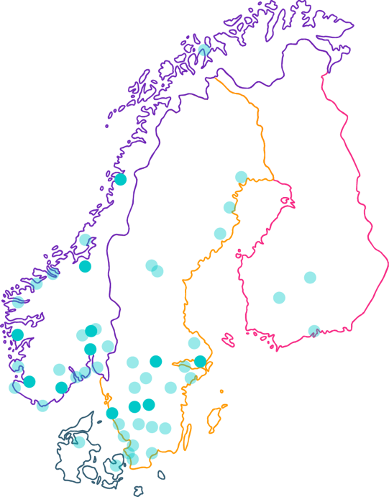

EVRY
– Nordic Champion
50 towns and cities with capacity to deliver
11 regional offices with specialist competencies
10.000 employees
Women
Age
Universum
26%
39yrs
#4
100+ employees

Slide 6
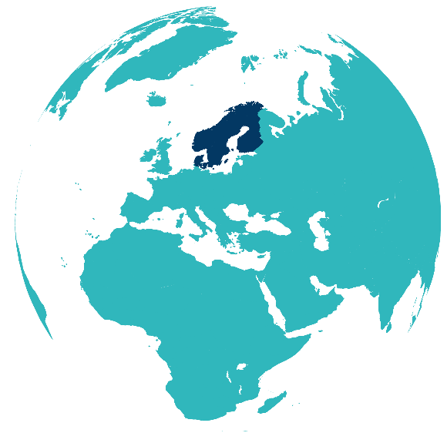
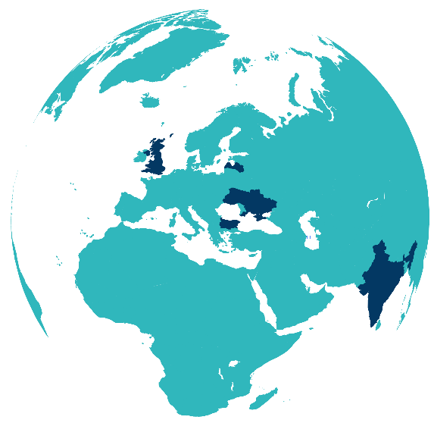
EVRY GROUP - Geographic distribution
Nordics
Rest of the World (Global Delivery)

Slide 7
NFT Department
Performance
Application layer
Security
Load
Endurance
Stress
Spike
Network layer
Wireless
PCI DSS
Reliability
Failover
Interruption
Recoverability
Load balancing
Front-end

Slide 8
Why OWASP ASVS?
Chapter II

Slide 9
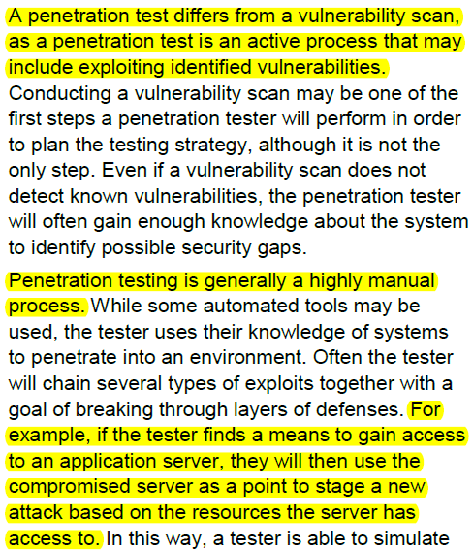
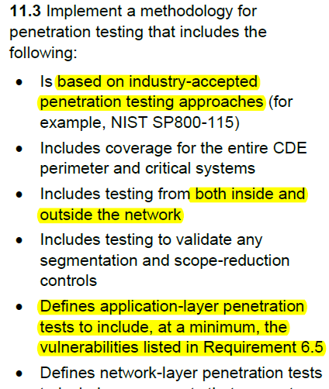
PCI DSS Requirement 11.3

Slide 10
PCI DSS Penetration Testing
External
AL
NL
Internal
AL
NL
Segmentation Checks

Slide 11
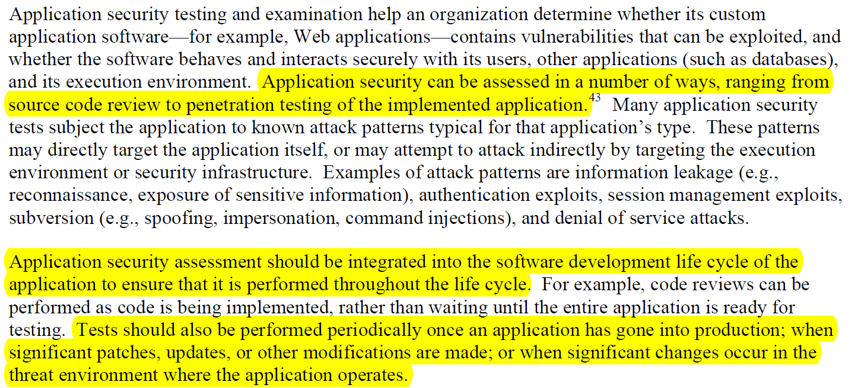
NIST SP 800-115: Appendix C - Application Security Testing and Examination

Slide 12
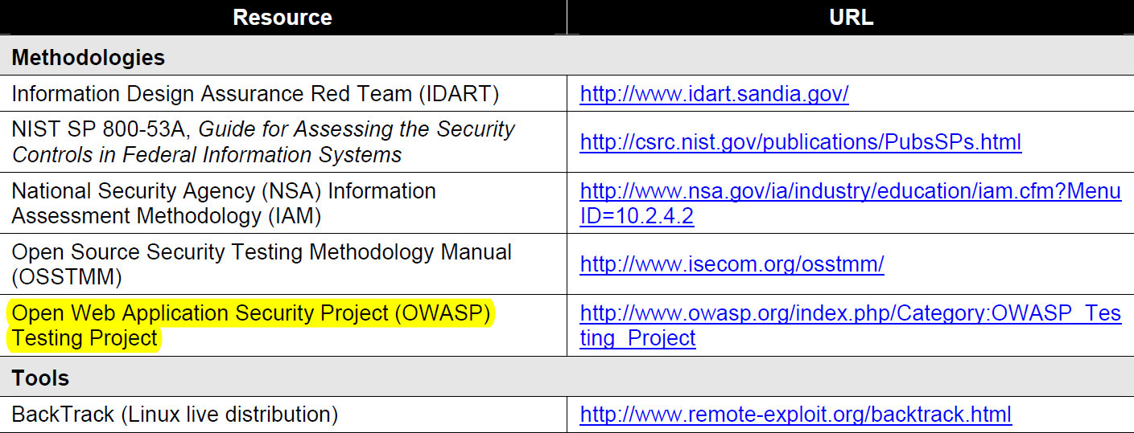
NIST SP 800-115: Appendix E - Table E-2. Online Resources

Slide 13
PCI DSS Penetration Testing - Summary
Methodology
Testing Guide
PCI DSS Requirement 6.5
PCI DSS Penetration Testing Guidance
NIST Special Publication 800-115
Open Source Security Testing Methodology Manual
Open Source Security Testing Methodology Manual (“OSSTMM”)
OWASP Testing Guide
Penetration Testing Execution Standard
Penetration Testing Framework
Injection flaws
Insecure communications
Cross-site scripting (XSS)
etc.
PCI DSS Requirement 11.3
Perform external penetration testing
Perform internal penetration testing
Verify segmentation methods
Improper error handling
Improper access control

Slide 14
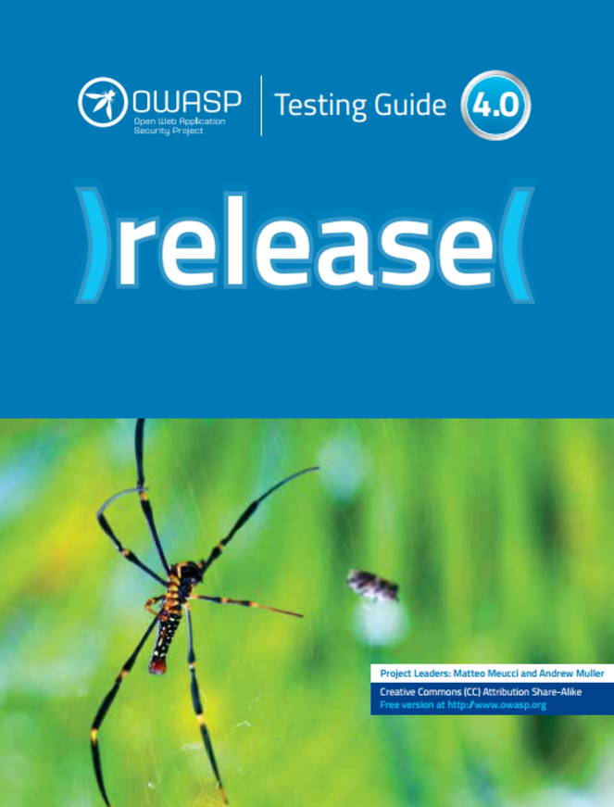
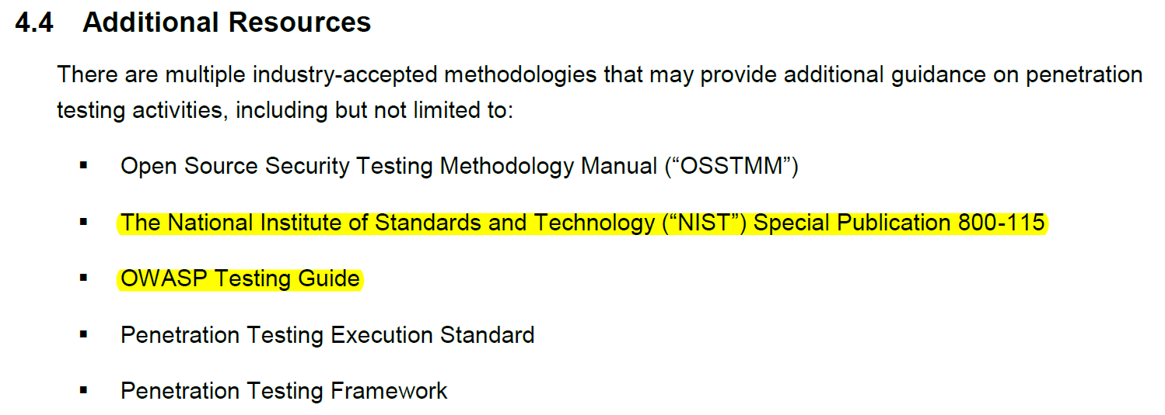
OWASP Testing Guide (from PCI Pentest Guide)

Slide 15
OWASP Top 10 2013 vs PCI DSS
A1 Injection
PCI DSS Requirements
6.5.1 Injection flaws / 6.5.2 Buffer overflows
A2 Broken Authentication and Session Management
A3 Cross-Site Scripting (XSS)
A4 Insecure Direct Object References
A5 Security Misconfiguration
A6 Sensitive Data Exposure
A7 Missing Function Level Access Control
A8 Cross-Site Request Forgery (CSRF)
A9 Using Components with Known Vulnerabilities
A10 Invalidated Redirects and Forwards
OWASP Top 10 2013
6.5.10 Broken authentication and session management
6.5.7 XSS
? -
? 6.5.6 All “high risk” vulnerabilities
? 6.5.5 Improper error handling
6.5.8 Improper access control / 6.5.3 Insec. cryptostorage
6.5.9 CSRF
6.5.6 All “high risk” vulnerabilities
? 6.5.4 Insecure communications

Slide 16
OWASP Application Security Verification Standard (ASVS)
OWASP Web Top 10
OWASP Code Review Top 9
OWASP ASVS v3.0.1
Architecture

Slide 17
Scope for the application security verification standard
Description of security verification levels
Requirements / Controls
Standards Mappings
Key parts of OWAS ASVS

Slide 18
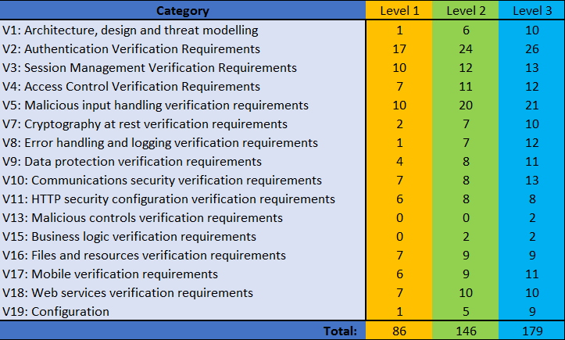
OWAS ASVS Verification Controls (v3.0.1)

Slide 19
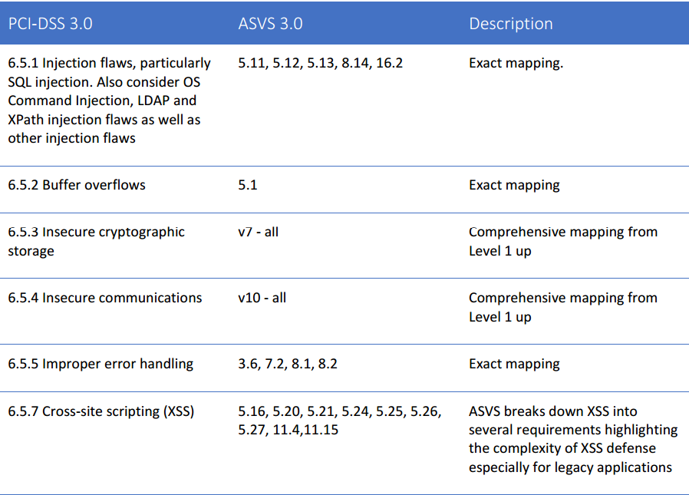
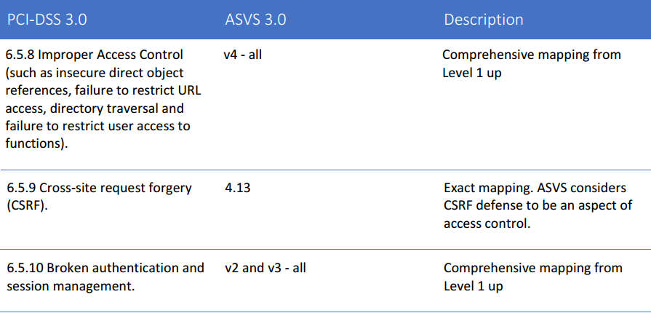
OWASP ASVS: Standards Mappings

Slide 20
Relation Between Requirements
OWASP ASVS
PCI DSS
OWASP Top 10

Slide 21
Scope for pentesting of web applications
OWASP TOP 10
EVRY
PCI DSS
EVRY FS
Security

Slide 22
OWAS ASVS in Practice
CHAPTER III

Slide 23
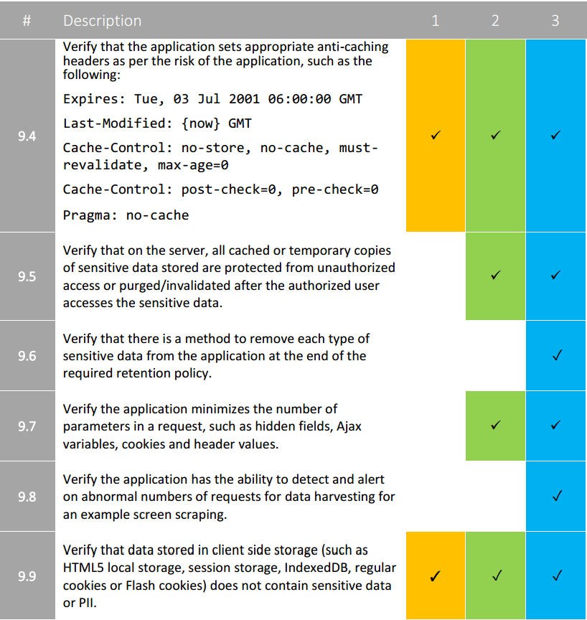
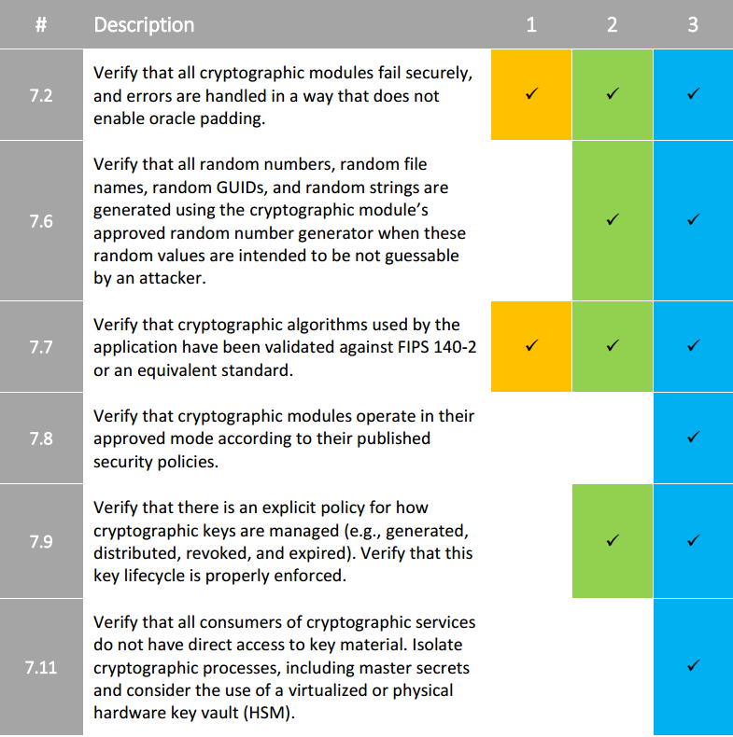
OWAS ASVS Verification Controls

Slide 24
OWAS ASVS Verification Controls (v3.0.1)

Slide 25
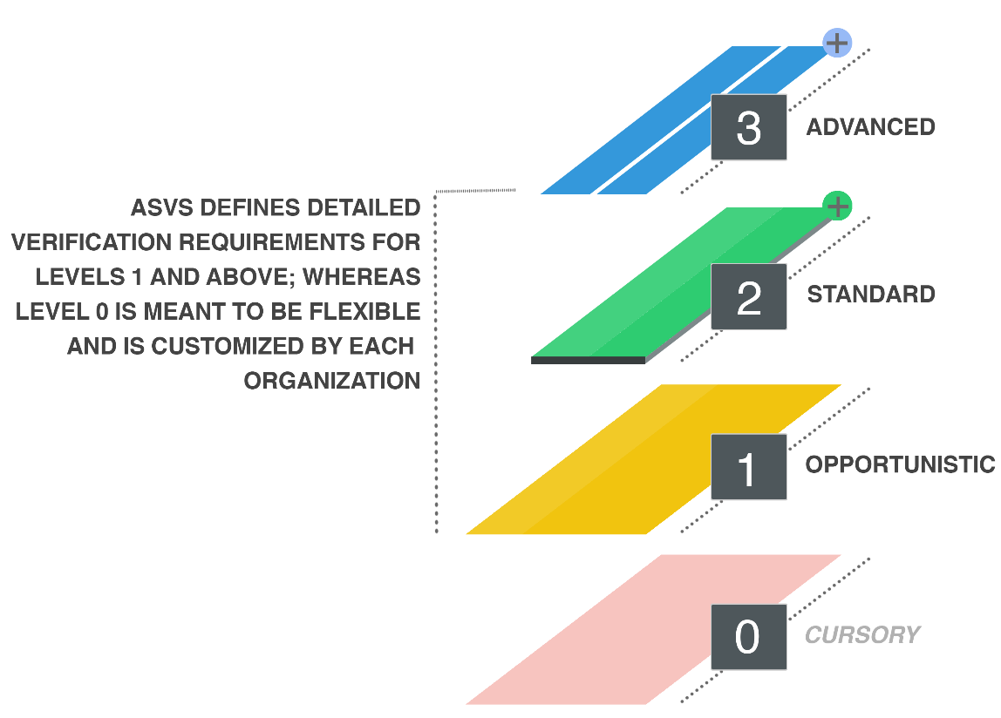
OWASP ASVS Levels
Opportunistic
Standard
Cursory
Advanced
Security
3
2
1
0

Slide 26
An Issue With Level Definition
Requirements
Level
AUT

Slide 27
Relation Between Project and NFT
NFT
Manager
Project Manager
Test Env
Manager
Functional Test Manager
Development
Manager
Project
Architect
NFT Manager
NFT Coordinator
NFT
Analyst

Slide 28
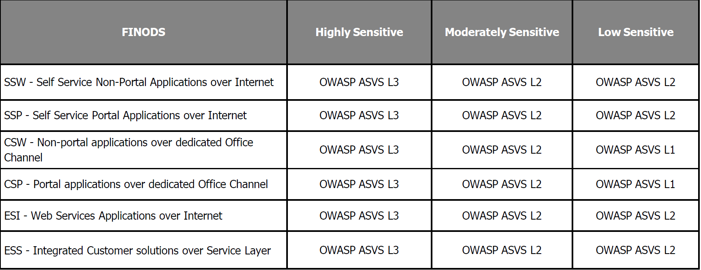
Compliance Selection at Financial Services

Slide 29
EVRY FINancial suite Operational Domains in SaaS (FINODS)
Loadbalancers
Area G
http-servers, MQ, filetransfer, SQLproxy, Internet Proxy
Area F
Card Portal / Clients
Portal, Internetbank and “non card clients”
EDB ESB WS_PROXY
Area E
WebServices – load-balancers / MQ
Area D
Card Services
Issuing, Acquiring and Security
Bank Services (non-Card)
Batch, Analysis, Security, Online
Area C
Database servers – Cards
Database servers – serving area C and E
Area B
PCI
NON
PCI
Disk SAN – dedicated SAN's to critical systems
Area A
= Security areas

Slide 30
Authentication in Cardholder Client (CHC) Using LoginService2 (LS2)
LoginService2
3
4
6
5
Browser
SO Service
10
9
2
Cardholder Client
7
1
8

Slide 31
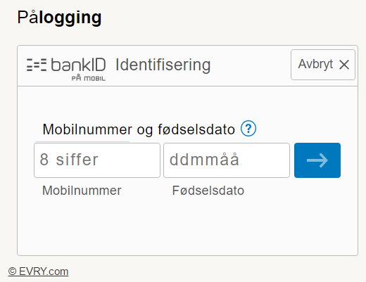
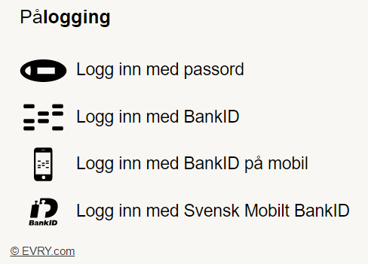
LoginService2

Slide 32
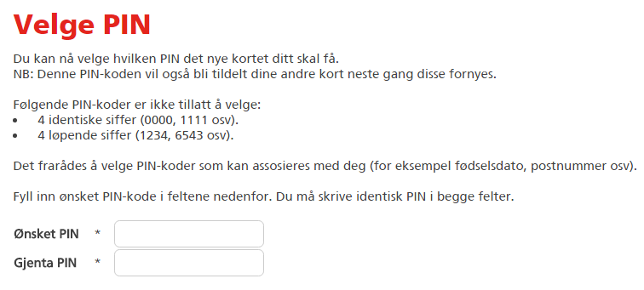
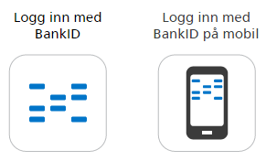
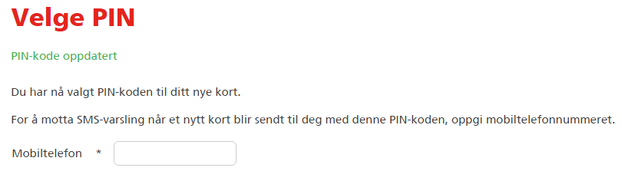
Cardholder Client

Slide 33
General Information on LS2 and CHC
LoginSevice2
Cardholder Client
LS2 stays in front of almost all applications
It is the first major security barrier
LS2 helps to retrieve tokens (Secure Object or simply SO) and hand over it to the 3rd party applications
CHC is a part of EVRY’s NetBank (Online banking)
It can be integrated with any 3rd party web application
EVRY’s NetBank is protected by LoginsService2 in front of CHC
After logging in CHC uses SO as the main parameter in session management
Available through the Internet
Available through the Internet
OWASP ASVS Level 3
OWASP ASVS Level 2

Slide 34
Security Application Life Cycle
6 months
(1 year by PCI DSS)
No or minor changes
Security assessment
Application update
Partial
Full
New functionality
Full pentest

Slide 35



Summary
PCI DSS is a good starting point for any infrastructure
OWASP ASVS is a flexible standard with minimal effort for adaptation
For a stable security development lifecycle the following should be implemented
Standard operation procedures
Methodology for security testing
Security risk assessment
Role descriptions
General compliance levels

